Slide 1
Connecticut’s
Dark Day
CTHEducation

Slide 2
How can tree rings help us solve a 245-year-old historical mystery?

Slide 3
On May 19, 1780, a strange darkness fell over much of New England, including Connecticut, when the colonies were fighting for independence. It was so dark by noon that it was impossible to read or write even sitting by a window – people had to light candles to see.

Slide 4
“People were unable to read, determine the time of day by their clocks or watches, dine, or manage their domestic business, without the light of candles…
The birds having sung their evening songs, disappeared and became silent; the fowls retired to roost; the cocks were crowing all around, as at break of day; objects could not be distinguished but at a very little distance, and everything bore the appearance and gloom of night.

Slide 5
Early in the morning, the weather was cloudy: the sun was but just visible through the clouds, and appeared of a deep red…
In most places thunder was heard several times in the morning…
In some places there were showers throughout the day.
The water that fell was found to have an uncommon appearance, being thick, dark, and sooty.”

Slide 6
What did people notice?

Slide 7
What do you think caused the darkness?

Slide 8
In Hartford, there was a legislative meeting in progress at the Old State House in the middle of a debate.
The House decided to adjourn the meeting because of the darkness, but Abraham Davenport, a member of the Council, asked for candles to be brought instead so he could keep doing his duty.
He helped his colleagues feel less fearful about the day
and in doing so became a hero!

Slide 9
What would you have done if you were in Davenport’s position?
Would you have kept working?

Slide 10
Through scientific evidence, we’ve learned that the cause of the darkness was....

Slide 11
smoke from a forest fire...
all the way up in Canada!

Slide 12
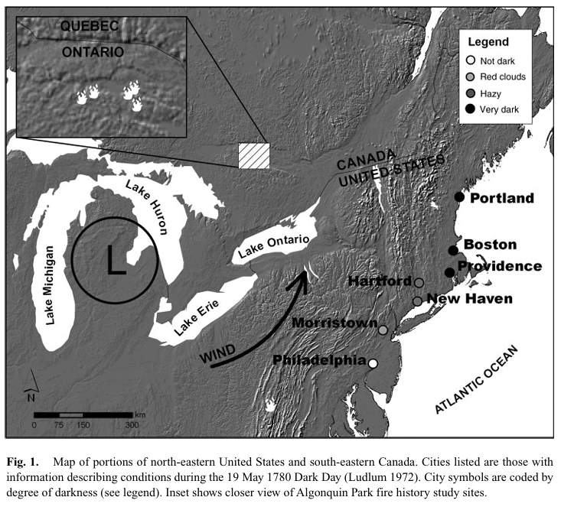

Slide 13
Scientists learned about the fire by using what’s called dendrochronology,
or the study of tree rings.
Trees can live for hundreds, or even sometimes thousands, of years! By counting a tree’s rings, you can find out how old it is.

Slide 14
We can also see weather patterns in the rings:
Rings are thicker in years with long, warm, or wet growing seasons.
The trees might have had less competition for resources like sun and water.
The rings are thinner in years where there might have been a drought, cold snaps, disease, pests, or even fires, which leave scars on the rings.

Slide 15
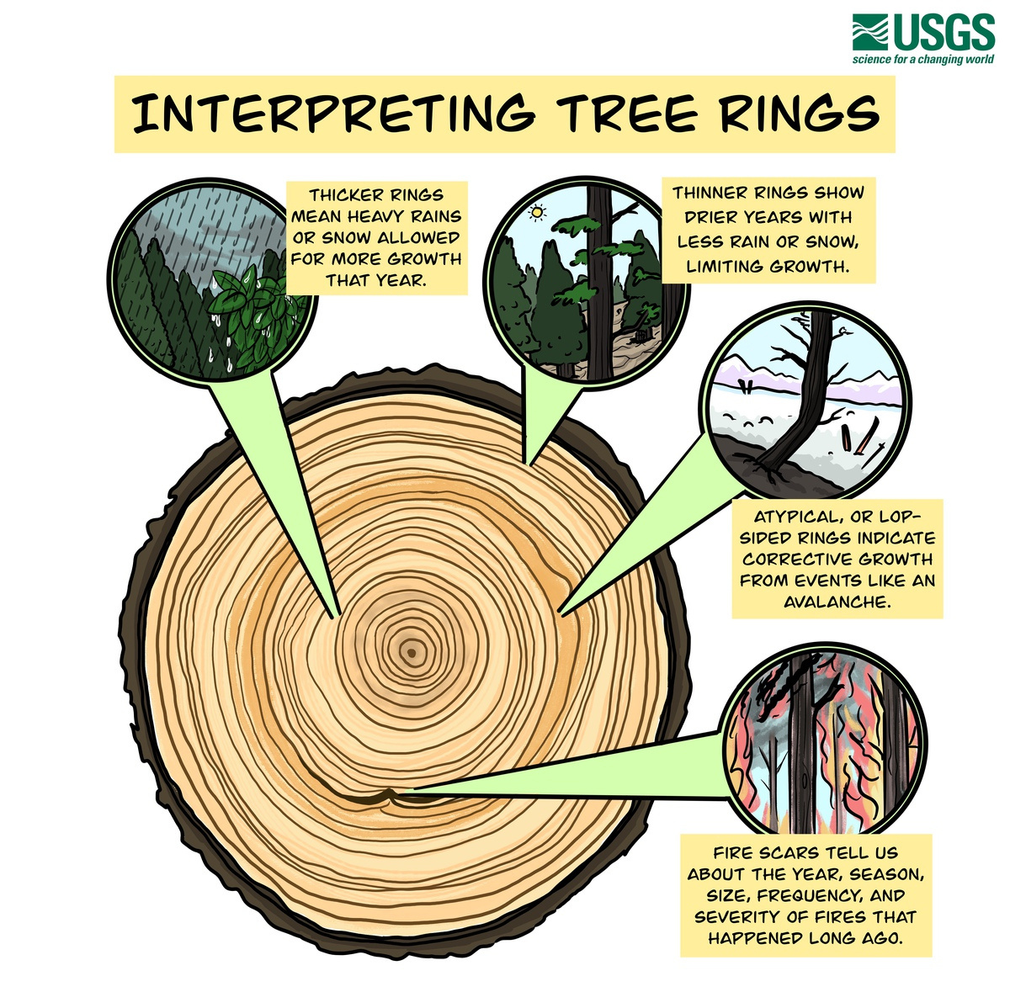

Slide 16
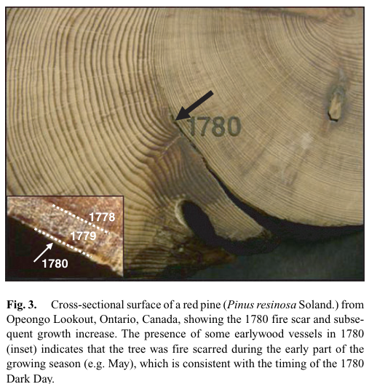

Slide 17
Why were there so many fires in 1780?

Slide 18
Settlement
Conflict between Native Americans and Euro-American settlers ⟶ fires were often ignited purposefully for revenge or defense
Spread accidentally from campfires, lanterns and candles
Clearing land and the subsequent burning of extremely large slash piles
Weather
Combination of drought and a low pressure weather system may have increased the potential for ignition by lightning

Slide 19

Tree Ring Gradient Worksheet

Slide 20
What do different rings and scars tell us about a tree’s life?
Closing Questions
Why is it important for us to study the Earth’s history?
What might events in the past tell us about the future?

Slide 21
“Dark Day – Today in History: May 19" ConnecticutHistory.org. 19 May, 2020. https://connecticuthistory.org/dark-day-today-in-history-may-19/
McMurry, Erin R.; Stambaugh, Michael C.;Guyette, Richard P.; Dey, Daniel C. 2007. Fire scars reveal source of New England's 1780 Dark Day. International Journal of Wildland Fire. 16: 266-270.
Slyngstad, Ben. “Tree Rings” USGS/Climate Adaptation Science Centers, 22 Jan, 2024. Public Domain. https://www.usgs.gov/media/images/tree-rings
Sources

Slide 22
CTHEducation

