Slide 1
A Day in the Life:
Recording Our History
CTHEducation

Slide 2
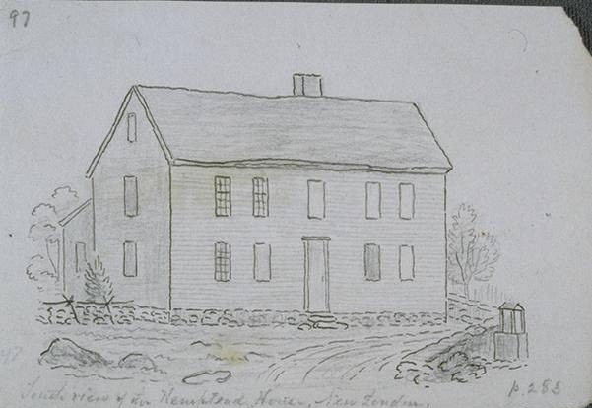
Who was Joshua Hempsted?
Joshua Hempsted was a man who lived nearly 300 years ago in New London, Connecticut. He began keeping his diary to keep track of his many business activities, but he didn't just write about work! For 47 years (from 1711 through 1758), he wrote every single day.
A drawing of Hempsted’s house
John Warner Barber, South view of the Hempsted House,
New London, ca. 1836, pen and ink
Connecticut Museum of Culture and History

Slide 3
What did
he write about?
  The date
  The weather
  Town meetings
  Work done on his farm
  Births
  Deaths
  Military activity
  When ships came and went
  Places he traveled
  People he met
  So much more!

Slide 4
Become a Historian
Your job this week is to become historians of your own lives! You are going to create your own diary entries, trying to be as detailed as Joshua Hempsted was, recording not just what you do, but the events and observations that make up
your day.

Slide 5
Work and Chores
Community Events
  Schoolwork
  Homework
  Farm chores
  Cleaning tasks
  Club meetings
  Team meetings
  Assemblies
Important Life Events
Travel and Observations
  Birthday parties
  Visits from relatives
  Personal milestones
  Trips to the store
  Visiting friends
  Vacations/longer trips

Slide 6



Today’s Activity:
Write a diary entry
Today’s Date ___________________
Today’s Weather: Circle one
Include:
Date and Weather
Daily Activities
  Work and Chores
  Community Events
  Important Life Events
  Travel and Observations
Draw a Picture
Dear Diary,
Draw a picture to represent
today here.

Slide 7
Your Homework
Record a diary entry for every day this week.
At the end of the week, we will share!

