Slide 1
Turn-and-Talk:
How do you think your education in Connecticut compares to the education students receive in other states?
What rights do you believe you have as a student regarding your education?
How do you think the government ensures that all students receive a quality education?

Slide 2
Code of Laws for the Colony of Connecticut (Ludlow’s Code)
Adopted in 1650
Established two fundamental principles regarding education:
The first mandated that the state compel parents and guardians to educate children
The second allowed public funds, collected through taxes, to be used for education
Additionally, towns with 50 households were required to appoint a teacher, and once a town reached 100 families, it had to establish a grammar school to prepare students for university.

Slide 3
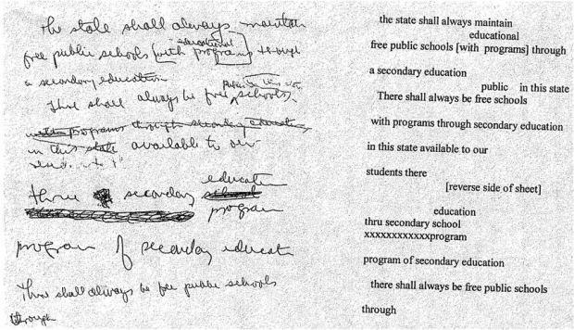
Bernstein’s Educational Amendment
Article 8, Section 1
"There shall always be free public elementary and secondary schools in the state. The general assembly shall implement this principle by appropriate legislation."
Bernstein was given only minutes to draft his proposal for what is known today as the 1965 Education Amendment. The above image is a facsimile of the document. The actual draft of the Article is held at the Connecticut State Library.

Slide 4
Exit Ticket: “Do I Just Sit Here or Do I Do Something?”
You have a great idea for a change that you believe is essential for your school, community, or state (e.g., a new school policy, a community improvement, a state law). You have managed to get the attention of a decision-making body, but there is limited time on the agenda.
You have five minutes: quickly brainstorm and write down the core idea of your proposed change and why it's important.
Aim for clarity and focus: you can't include every detail!

