Slide 1
Discussion Groups
Type in Student Names for groups in the boxes

Slide 2
Stop and Chat
When you think of a town or city, what is one that comes to mind?
What kinds of things can you find in a town or city?
What needs to be considered when towns are created?
Who makes decisions about how towns develop, grow, or change?
What makes one town or city different from another town or city?

Slide 3
Types of Questions
Closed-Ended Question Usually begin with did, what, where, or when A closed question can be answered with either a single word or a short phrase. They give you facts. They are easy to answer. They are quick to answer. Examples: Did the Pilgrims travel to America on a ship? Where was the first colony that the European settlers created? | Open-Ended Questions Usually begin with how or why It opens the door to possibilities! An open question is likely to receive a long answer (paragraph, essay). You have to think and reflect about the answers. They will give you opinions and feelings. They ask for elaboration (explaining why something is). May have two parts of a question. (What are some weapons the indigenous people used? How did each one help their tribe?) Example: Why did Europeans want to explore America?

Slide 4
Q FOCUS QUESTION PROTOCOL
Ask as many questions as you can.
Do not stop to answer, judge or discuss the questions.
Record the question exactly as it is given.
Change any statement into a question.

Slide 5
Stonington’s history makes it a special town in Connecticut.

Slide 6
Student Questions

Slide 7
After our Field Trip…
Let’s review our questions!
Now that we have been on our field trip, do we have any additional questions to add?
What questions can we start to answer since our trip?

Slide 8
Our Questions that Connected to our Trip!
What happened in Stonington’s past?
Who are some cool/famous people in Stonington’s history? Why are these people famous?
What makes Stonington different from other towns?
How is the Atlantic Ocean important to Stonington’s history?
What foods are eaten here? Why?
Where is Stonington in the state of Connecticut?
What was invented in Stonington? Why? When? How?
What are some important buildings? Why are they important?
What are some jobs that are part of Stonington’s history? Why are these jobs important?
What businesses (restaurants or stores) are part of Stonington’s history?
Write down 3 questions you would like to learn more about!

Slide 9
Now that you have your Group’s Question:
You have been assigned one of your chosen questions along with 1 or 2 other group members.
Complete additional research to answer the question (Group Task)
Write a RACE response to answer the question (Independent Task)
Create a visual project that answers the question (Group Task)
Check out our Rubric Here

Slide 10
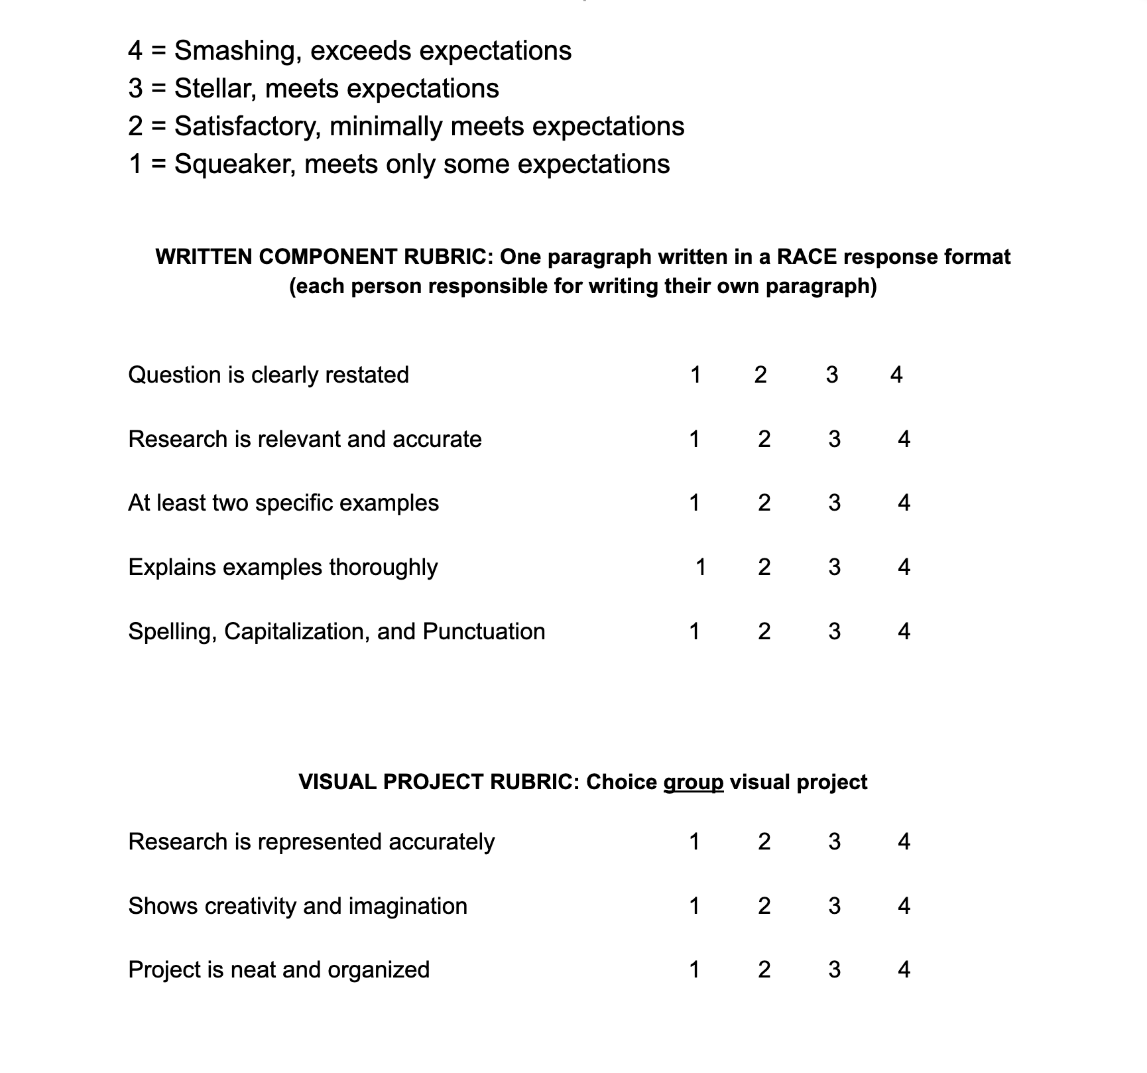
Scoring Rubric

Slide 11
RACE RESPONSE
Restate the question
Answer the question
Cite evidence from the text
Explain how the evidence supports your answer

Slide 12
Presentation Time! It’s time to share your visual projects with your classmates!
Include your question and your answer(s)
Show the details in your project that support your answer
Everyone in your group should have a role
Use a loud, clear voice
Be prepared to answer questions in the end

